Slide 1

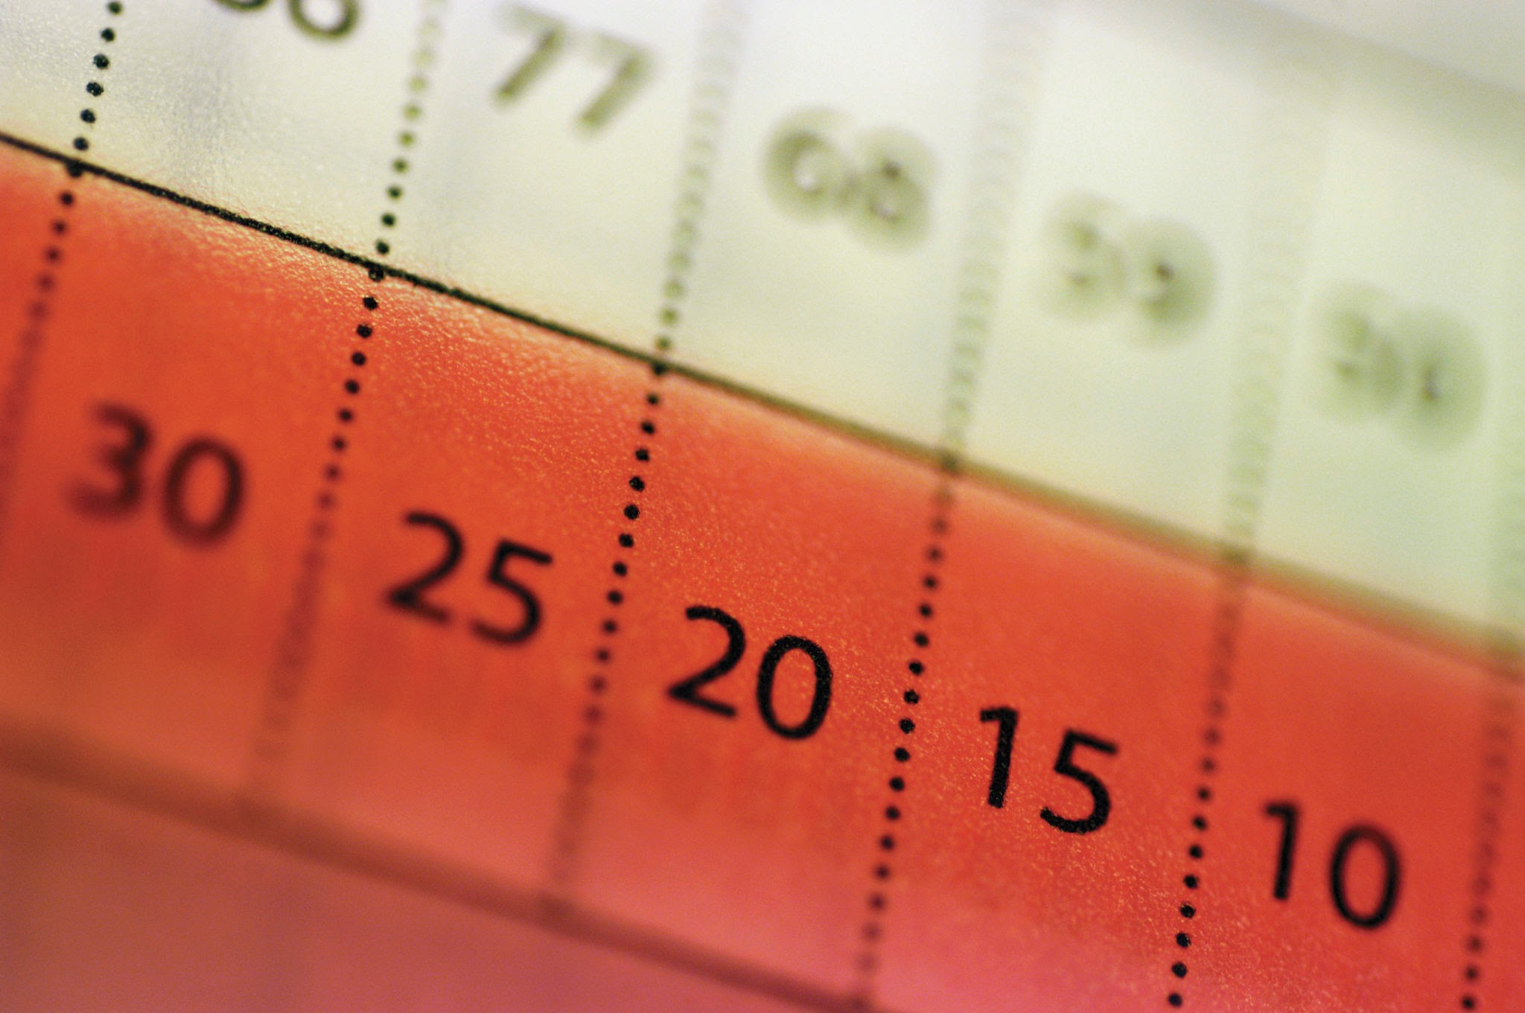
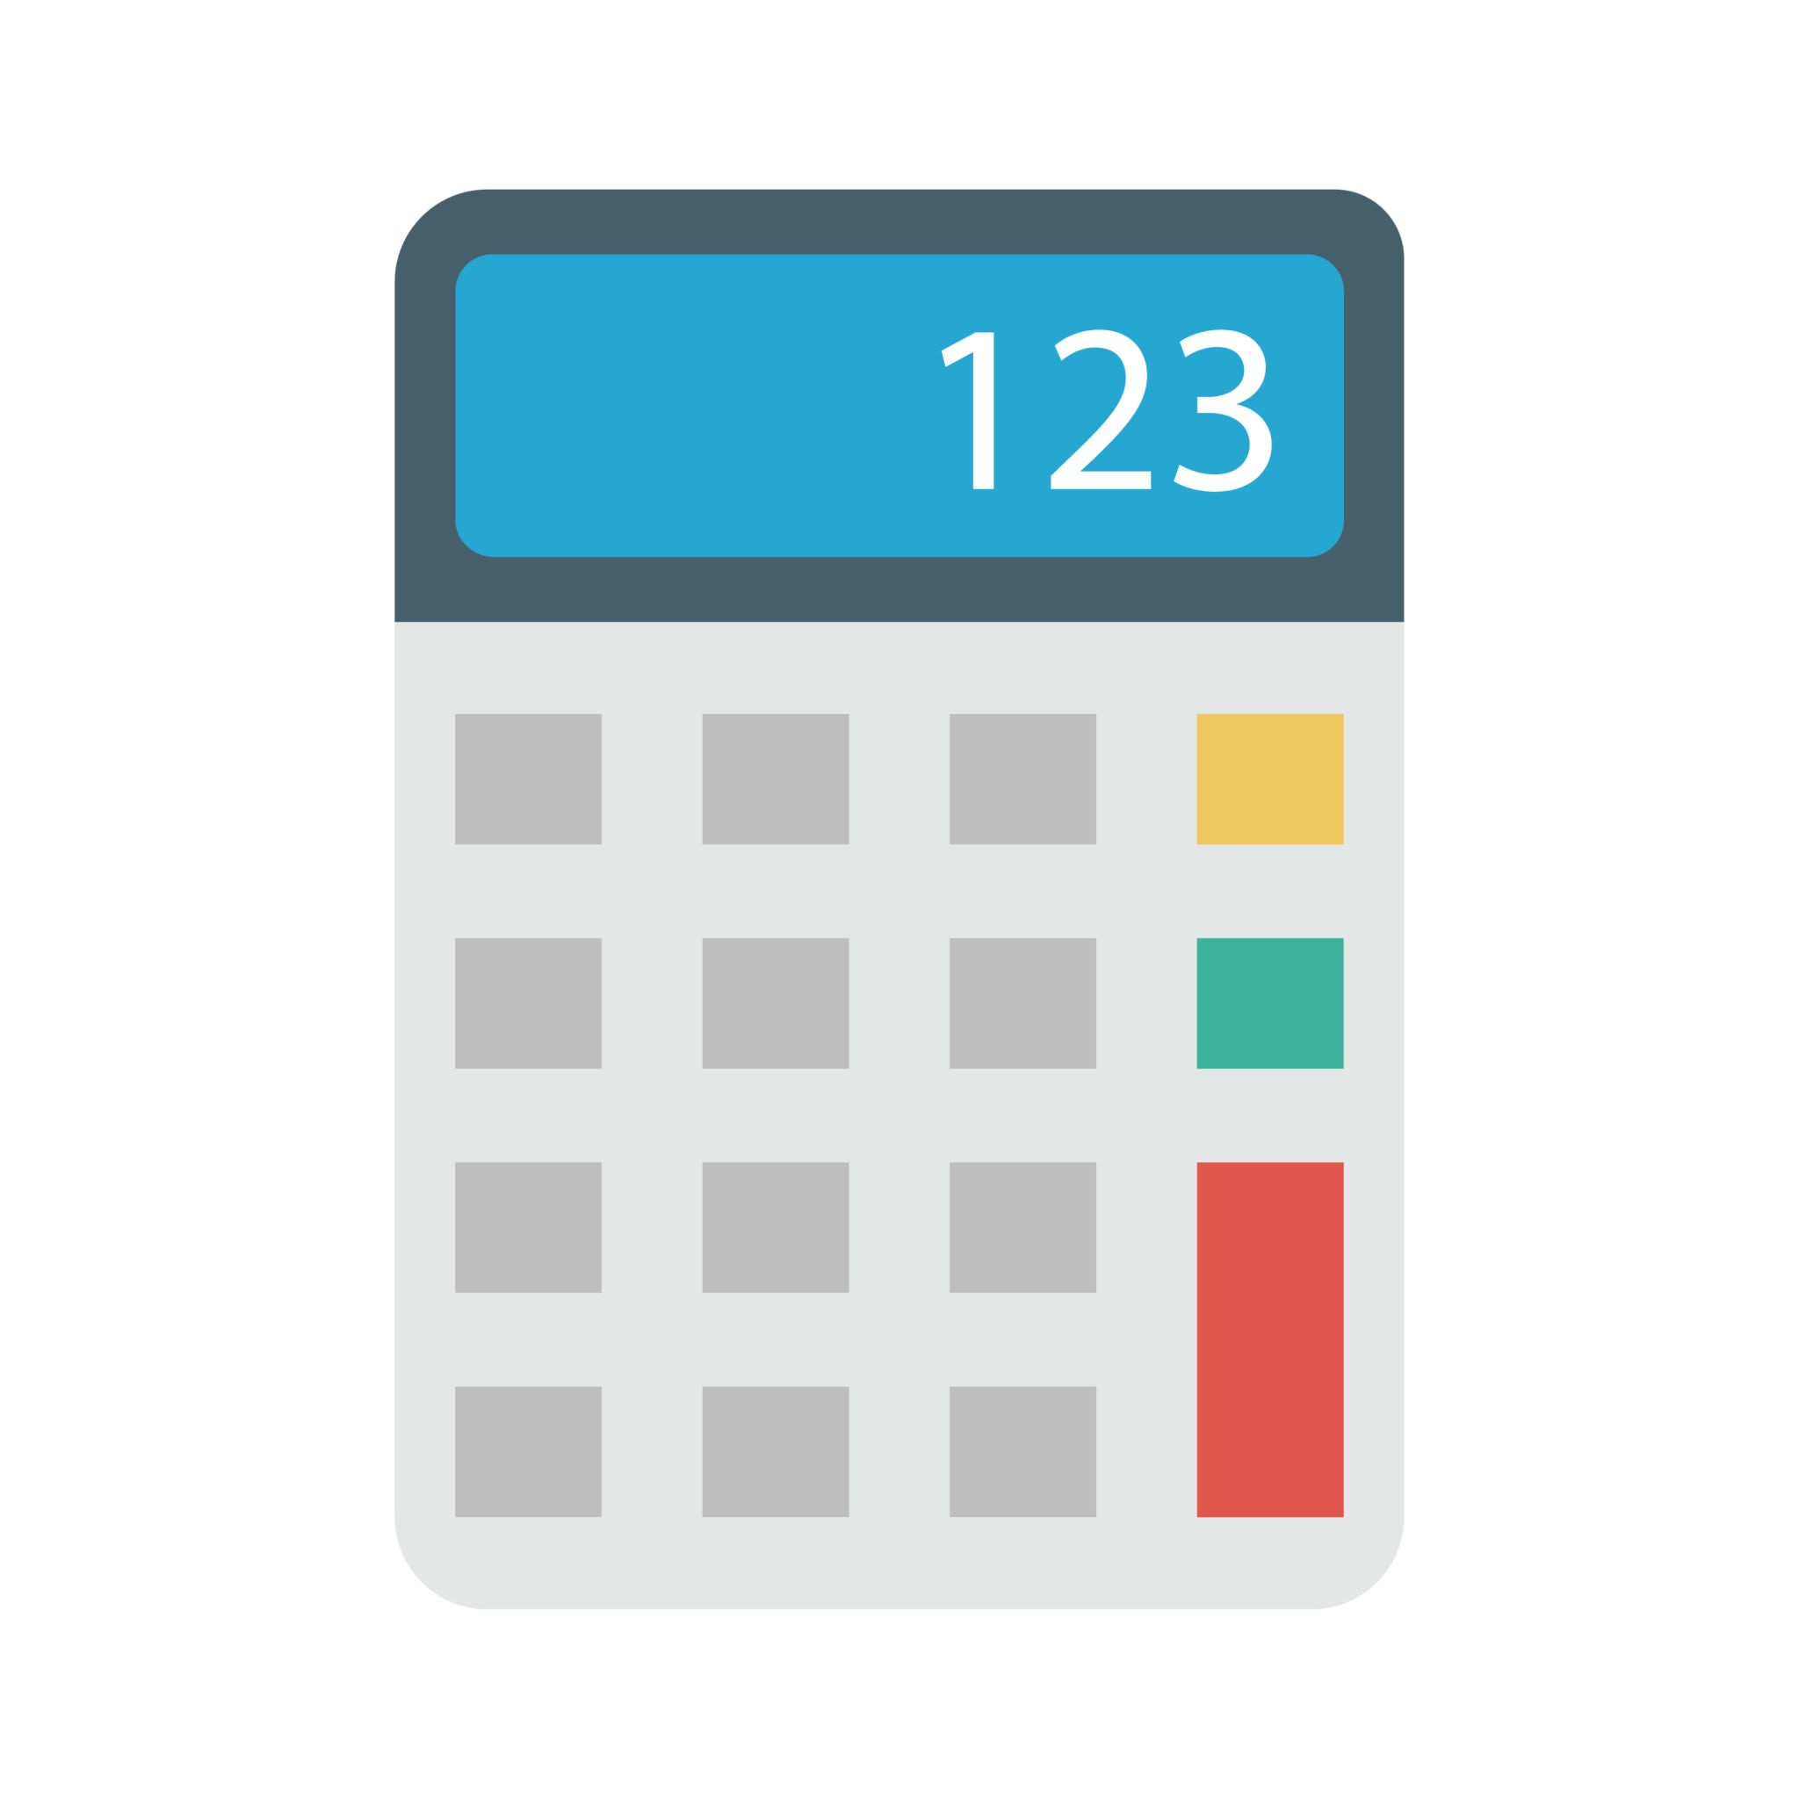

Department of Computer Science and Engineering, BRAC University
Lecture 1
Number System & Calculations
CSE260 : Digital Logic Design

Slide 2
Objective
Analog vs. Digital
Distinguish between analog and digital system
Understand the advantage and limitation of digital system
Understand the meaning of digital logic
Analog data can vary over a continuous range of values.
Example: speedometer
Digital quantities can take on only discrete values (0 and 1, high and low). Example: Digital Computer, Decimal Digits, Alphabets
‹#›
Department of Computer Science and Engineering
CSE260 - Digital Logic Design

Slide 3
Digital System
A digital system is a combination of devices designed to manipulate physical quantities or information that are represented in digital form.
“A discreet information processing system”
Signals: Discreet information
‹#›
Department of Computer Science and Engineering
CSE260 - Digital Logic Design

Slide 4
Digital System Advantages
Limitation
Greater accuracy or precision
Easier to design (generality)
Easier information storage
Programmability (instructions)
Speed
Economical
The real world is mainly analog
‹#›
Department of Computer Science and Engineering
CSE260 - Digital Logic Design

Slide 5
How to Overcome the Limitations
Convert the real world analog input data into digital
Process this digital data
Then again convert into analog form
Processing
Analog
Input
A. to D.
Conversion
Digital Data
D. to A.
Conversion
Analog
Output
‹#›
Department of Computer Science and Engineering
CSE260 - Digital Logic Design

Slide 6
Digital Logic
Design logic is a term used to denote the design and analysis of digital system
Digital logic is concerned with the interconnection among digital components and modules
Digital logic design is engineering and engineering means problem solving
‹#›
Department of Computer Science and Engineering
CSE260 - Digital Logic Design

Slide 7
Number systems and codes
Digital Systems are built from circuits that process binary digits. BUT very few real-life problems are based on binary numbers
So, a digital system designer must establish some correspondence between the binary digits processed by digital circuits and real-life numbers, events and conditions
‹#›
Department of Computer Science and Engineering
CSE260 - Digital Logic Design

Slide 8
Information representation
Human decisions tends to be binary i.e. Yes or No
Elementary storage units inside computer are electronic switches. Each switch holds one of two states: on (1) or off (0).
ON (1)
OFF (0)
‹#›
Department of Computer Science and Engineering
CSE260 - Digital Logic Design

Slide 9
Information representation [cont.]
We use a bit (binary digit), 0 or 1, to represent the state
Storage units can be grouped together to cater for larger range of numbers. Example: 2 switches to represent 4 values
0 (00)
1 (01)
2 (10)
3 (11)
‹#›
Department of Computer Science and Engineering
CSE260 - Digital Logic Design

Slide 10
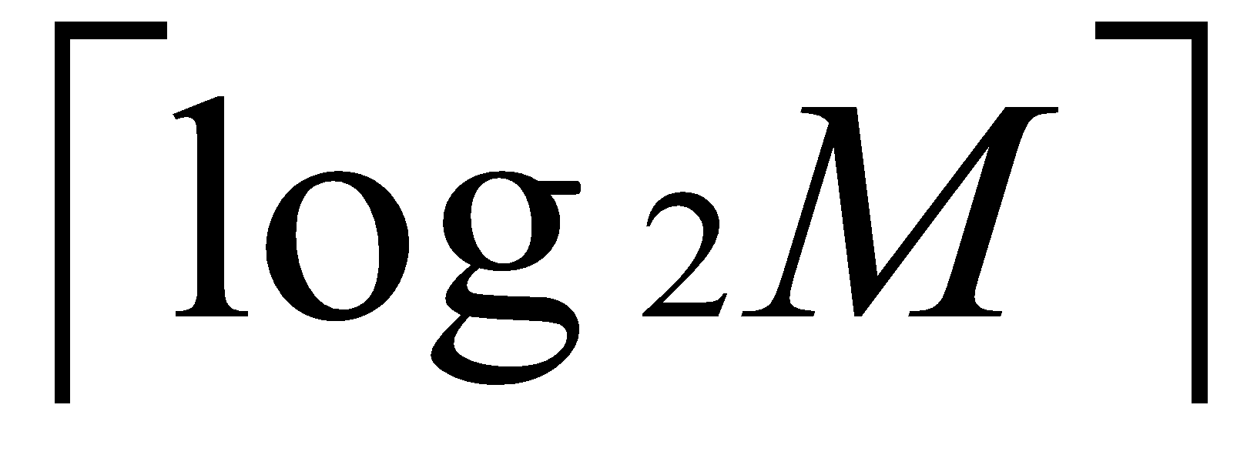
Information representation [cont.]
In general, N bits can represent 2^{N} different values.
For M values, bits are needed.
1 bit → represents up to 2 values (0 or 1)
2 bits → rep. up to 4 values (00, 01, 10 or 11)
3 bits → rep. up to 8 values (000, 001, 010. …, 110, 111)
4 bits → rep. up to 16 values (0000, 0001, 0010, …, 1111)
32 values → requires 5 bits
64 values → requires 6 bits
1024 values → requires 10 bits
40 values → requires 6 bits
100 values → requires 7 bits
‹#›
Department of Computer Science and Engineering
CSE260 - Digital Logic Design

Slide 11
Positional Notations
Decimal number system, symbols = { 0, 1, 2, 3, …, 9 }
Position is important
Example:
(7594)₁₀ = (7x10³) + (5x10²) + (9x10¹) + (4x10⁰)
In general,
(a_{n}a_{n-1}… a₀)₁₀ = (a_{n} x 10^{n}) + (a_{n-1} x 10^{n-1}) + … + (a₀ x 10⁰)
(2.75)₁₀ = (2 x 10⁰) + (7 x 10⁻¹) + (5 x 10⁻²)
In general,
(a_{n}a_{n-1}… a₀ . f₁f₂ … f_{m})₁₀ = (a_{n} x 10^{n}) + (a_{n-1}x10^{n-1}) + … + (a₀ x 10⁰) + (f₁ x 10⁻¹) + (f₂ x 10⁻²) + … + (f_{m} x 10^{-m})
‹#›
Department of Computer Science and Engineering
CSE260 - Digital Logic Design

Slide 12
Other Number Systems
Binary (base 2): weights in powers-of-2. Binary digits (bits): 0,1
Octal (base 8): weights in powers-of-8. Octal digits: 0,1,2,3,4,5,6,7
Hexadecimal (base 16): weights in powers-of-16. Hexadecimal digits: 0,1,2,3,4,5,6,7,8,9,A,B,C,D,E,F
Note: when base is r, coefficient values range from 0 to r-1.
‹#›
Department of Computer Science and Engineering
CSE260 - Digital Logic Design

Slide 13
Other Number
Systems [cont]
Binary | Octal | Decimal | Hexadecimal
0000 | 0 | 0 | 0
0001 | 1 | 1 | 1
0010 | 2 | 2 | 2
0011 | 3 | 3 | 3
0100 | 4 | 4 | 4
0101 | 5 | 5 | 5
0110 | 6 | 6 | 6
0111 | 7 | 7 | 7
1000 | 10 | 8 | 8
1001 | 11 | 9 | 9
1010 | 12 | 10 | A
1011 | 13 | 11 | B
1100 | 14 | 12 | C
1101 | 15 | 13 | D
1110 | 16 | 14 | E
1111 | 17 | 15 | F
Binary (base 2): weights in powers-of-2. Binary digits (bits): 0,1
Octal (base 8): weights in powers-of-8. Octal digits: 0,1,2,3,4,5,6,7
Hexadecimal (base 16): weights in powers-of-16. Hexadecimal digits: 0,1,2,3,4,5,6,7,8,9,A,B,C,D,E,F
‹#›
Department of Computer Science and Engineering
CSE260 - Digital Logic Design

Slide 14
Decimal to Base-R Conversion
Whole numbers: repeated division-by-R
Fractions: repeated multiplication-by-R
‹#›
Department of Computer Science and Engineering
CSE260 - Digital Logic Design

Slide 15
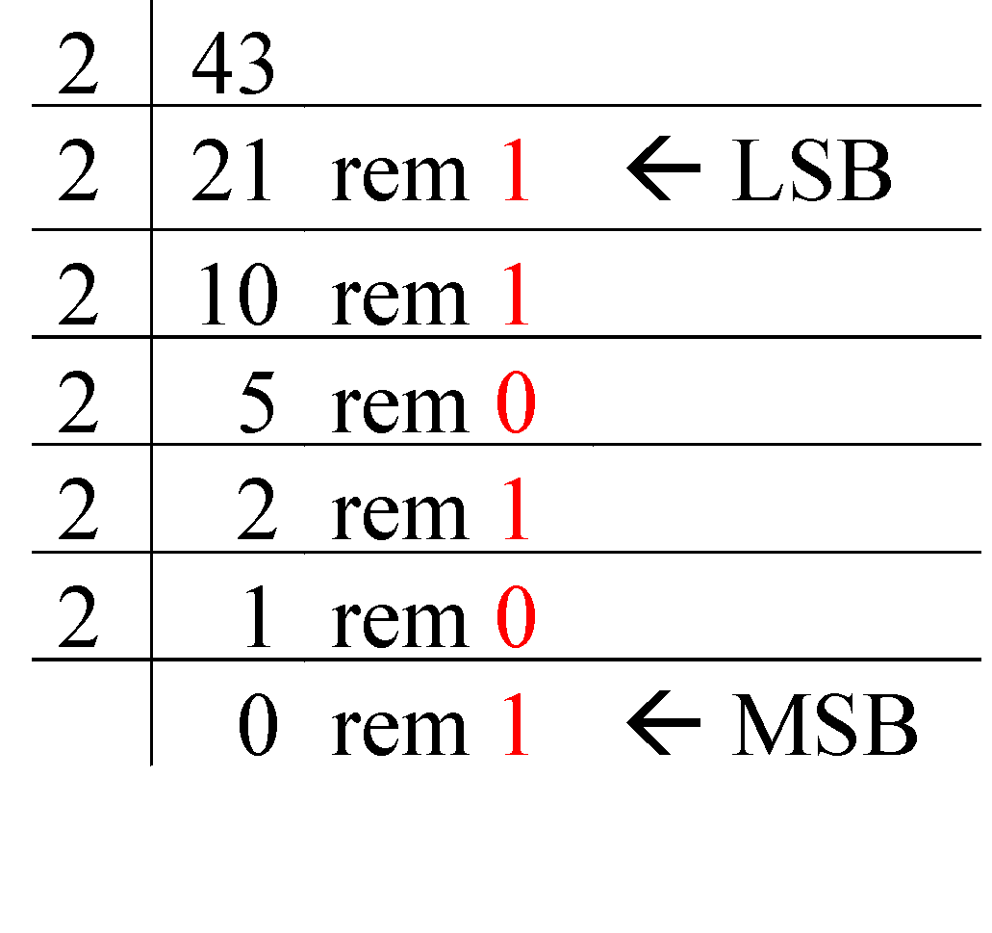
Repeated Division-by-2 Method
To convert a whole number to binary, use successive division by 2 until the quotient is 0. The remainders form the answer, with the first remainder as the least significant bit (LSB) and the last as the most significant bit (MSB).
(43)₁₀ = (101011)₂
‹#›
Department of Computer Science and Engineering
CSE260 - Digital Logic Design

Slide 16
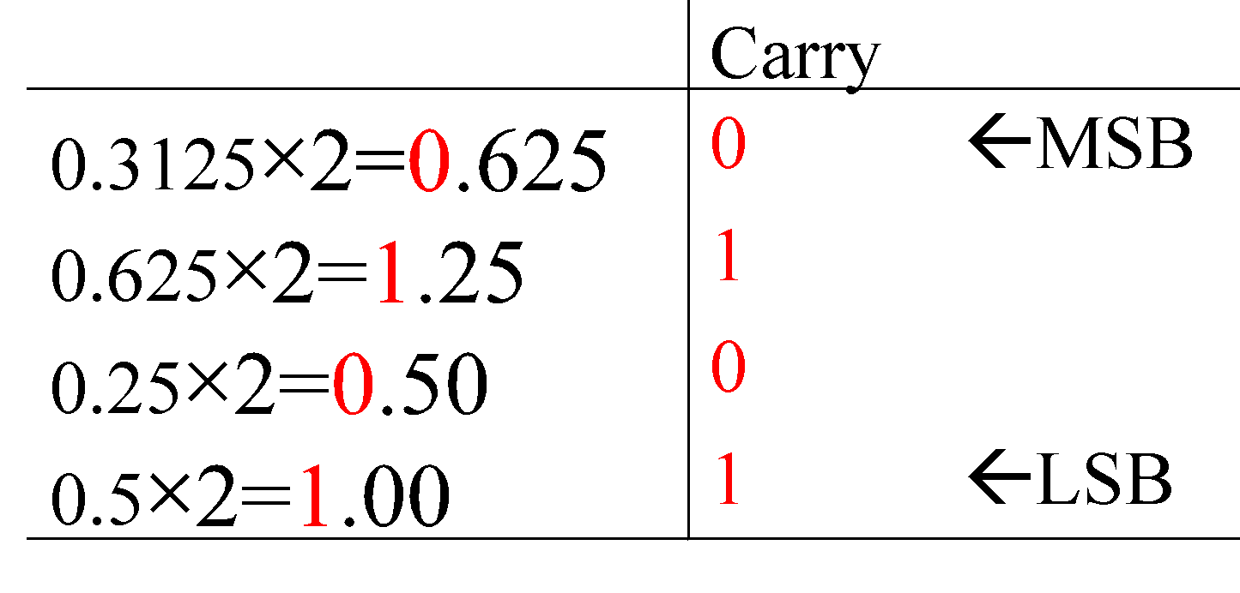
Repeated Multiplication-by-2 Method
To convert decimal fractions to binary, repeated multiplication by 2 is used, until the fractional product is 0 (or until the desired number of decimal places). The carried digits, or carries, produce the answer, with the first carry as the MSB, and the last as the LSB.
(0.3125)₁₀ = (.0101)₂
‹#›
Department of Computer Science and Engineering
CSE260 - Digital Logic Design

Slide 17
Repeated Multiplication-by-2 Method
Integer
Fraction
Division by base of target no. system
Remainders are accumulated
By division we obtain LSB to MSB
Multiplication by base of target no. system
Integers are accumulated
By multiplication we obtain MSB to LSB
‹#›
Department of Computer Science and Engineering
CSE260 - Digital Logic Design

Slide 18
Base-R to Decimal Conversion
***Formula= ∑ digit * source_base ^{position}
(1101.101)₂
= 1×2³ + 1×2² + 1×2⁰ + 1×2⁻¹ + 1×2⁻³
= 8 + 4 + 1 + 0.5 + 0.125
= (13.625)₁₀
(572.6)₈
= 5×8² + 7×8¹ + 2×8⁰ + 6×8⁻¹
= 320 + 56 + 2 + 0.75
= (378.75)₁₀
(2A.8)₁₆
= 2×16¹ + 10×16⁰ + 8×16⁻¹
= 32 + 10 + 0.5
= (42.5)₁₀
(341.24)₅
= 3×5² + 4×5¹ + 1×5⁰ + 2×5⁻¹ + 4×5⁻²
= 75 + 20 + 1 + 0.4 + 0.16
= (96.56)₁₀
‹#›
Department of Computer Science and Engineering
CSE260 - Digital Logic Design

Slide 19
Binary-Octal/Hexadecimal Conversion
Binary → Octal: Partition in groups of 3
(10 111 011 001 . 101 110)₂ = (2731.56)₈
Octal → Binary: reverse
(2731.56)₈ = (10 111 011 001 . 101 110)₂
Binary → Hexadecimal: Partition in groups of 4
(101 1101 1001 . 1011 1000)₂ = (5D9.B8)₁₆
Hexadecimal → Binary: reverse
(5D9.B8)₁₆ = (101 1101 1001 . 1011 1000)₂
‹#›
Department of Computer Science and Engineering
CSE260 - Digital Logic Design

Slide 20

Exercise
(1) Try converting this to
(10110001101011.111100000110)₂
a) octal
b) hexadecimal
(2) Try converting these to binary
a) (673.124)₈
b) (306.D)₁₆
‹#›
Department of Computer Science and Engineering
CSE260 - Digital Logic Design

Slide 21
Exercise Answers
1. a) (26153.7406)₈
b) (2C6B.F06)₁₆
2. a) (110 111 011 . 001 010 100)₂
b) (0011 0000 0110 . 1101)₂
‹#›
Department of Computer Science and Engineering
CSE260 - Digital Logic Design

Slide 22
Exercise
(1054)₆ = (?)₁₅
Solution:
Step 1: (1054)₆ = (?)₁₀
=> 1 x 6³ + 0 x 6² + 5 x 6¹ + 4 x 6⁰
=> 250
So, (1054)₆ = (250)₁₀
‹#›
Department of Computer Science and Engineering
CSE260 - Digital Logic Design

Slide 23
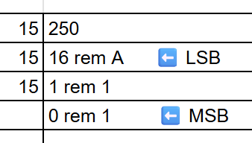
Exercise
Step 2: (250)₁₀ = (?)₁₅
So, (250)₁₀ = (11A)₁₅
(1054)₆ = (11A)₁₅
‹#›
Department of Computer Science and Engineering
CSE260 - Digital Logic Design

Slide 24
Exercise
(10A1B)₁₃ = (?)₁₈
Solution:
Step 1: (10A1B)₁₃ = (?)₁₀
=> 1 x 13⁴ + 0 x 13³ + A x 13² + A x 13¹ + B x 13⁰
=> 30275
So, (10A1B)₁₃ = (30275)₁₀
‹#›
Department of Computer Science and Engineering
CSE260 - Digital Logic Design

Slide 25
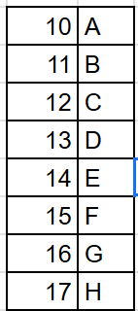
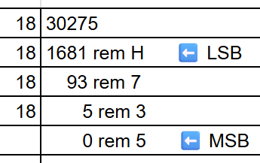
Exercise
Step 2: (30275)₁₀ = (?)₁₈
So, (30275)₁₀ = (537H)₁₈
(10A1B)₆ = (537H)₁₈
‹#›
Department of Computer Science and Engineering
CSE260 - Digital Logic Design

Slide 26
Binary Addition: Addition Rules w/Carries
For 2 bit
For 3 bit
0 + 0 = 0 0
( 0 with a 0 carry )
0 + 1 = 0 1
( 1 with a 0 carry )
1 + 0 = 0 1
( 1 with a 0 carry )
1 + 1 = 1 0
( 0 with a 1 carry )
0+0+0 = 0 0
(0 with 0 carry)
0+0+1 = 0 1
(1 with 0 carry)
0+1+1 = 1 0
(0 with 1 carry)
1+1+1 = 1 1
(1 with 1 carry)
‹#›
Department of Computer Science and Engineering
CSE260 - Digital Logic Design

Slide 27
Adding Binary Numbers
0
1
1
1
0
0
0
28
43
71
⎯→ 00011100
⎯→ + 00101011
0
1
0
0
0
1
1
1
‹#›
Department of Computer Science and Engineering
CSE260 - Digital Logic Design

Slide 28
Exercise
(3) Add (101101)₂ with (100111)₂
‹#›
Department of Computer Science and Engineering
CSE260 - Digital Logic Design

Slide 29
Exercise Solution
(3) (1010100)₂
Working:
Augend: 101101
Addend: +100111
Sum: 1010100
‹#›
Department of Computer Science and Engineering
CSE260 - Digital Logic Design

Slide 30
Addition of base-r
Example:
(34)₅+(41)₅+ (24)₅
2 1
( 3 4 )₅
( 4 1 )₅
+ ( 2 4 )₅
________________
(2 0 4)₅ (Ans)
4+1+4= 9
9%5=4 (sum)
9/5=1 (carry)
1+3+4+2= 10
10%5=0 (sum)
10/5=2 (carry)
‹#›
Department of Computer Science and Engineering
CSE260 - Digital Logic Design

Slide 31
Exercise
(4) (a) (FF)₁₆+(F1)₁₆
(b) (66)₇ + (55)₇
Solution
(a) (1F0) ₁₆
(b) (154) ₇
‹#›
Department of Computer Science and Engineering
CSE260 - Digital Logic Design

Slide 32
Binary Multiplication
The multiplication of two binary numbers can be carried out in the same manner as the decimal multiplication.
Unlike decimal multiplication, only two values are generated as the outcome of multiplying the multiplication bit by 0 or 1 in the binary multiplication. These values are either 0 or 1.
The binary multiplication can also be considered as repeated binary addition. Therefore, the binary multiplication is performed in conjunction with the binary addition operation.
‹#›
Department of Computer Science and Engineering
CSE260 - Digital Logic Design

Slide 33
Exercise
(5) Multiply 1011 with 101
Multiplicand 1011
Multiplier x 101
Partial Product 1011
0000X
1011XX
Product 110111
‹#›
Department of Computer Science and Engineering
CSE260 - Digital Logic Design

Slide 34
Multiplication with base-r
2A3C
xB7
127A4
1D094X
1E30E4
7*C = 7*12 = 84 =(write 4, carry 5) 7*3+5 = 26 = 1A (write A, carry 1) 7*A+1 = 71 = 0x47 (write 7, carry 4) 7*2+4 = 18 = 0x12 This completes the 7*2A3C = 127A4 partial product. B*C = 11*12 = 132 = (write 4, carry 8) B*3+8 = 11*3+8 = 41 = (write 9, carry 2) B*A+2 = 11*10+2 = 112 = (write 0, carry 7) B*2+7 = 11*2+7 = 29 = 1D This completes the B[0]*2A3C = 1D094[0] partial product, where I'm noting the [0] digits to remind us this is in the 16s column. Adding the partial products: 127A4 + 1D0940 4+0 = 4 A+4 = E 7+9 = 16 = 0x10 (write 0, carry 1) 2+0+1 = 3 1+D = E 1 = 1
Working
‹#›
Department of Computer Science and Engineering
CSE260 - Digital Logic Design

Slide 35
Exercise
(6) (a) Multiply (34)₅ with (42)₅
(b) Multiply (25)₉ with (36)₉
Solution
(a) (3133)₅
(b) (1033)₉
‹#›
Department of Computer Science and Engineering
CSE260 - Digital Logic Design

Slide 36
Binary Subtraction: Rules w/Carries
For 2 bit
0 - 0 = 0 0 ( 0 with a 0 carry )
1 - 1 = 0 0 ( 0 with a 0 carry )
1 - 0 = 0 1 ( 1 with a 0 carry )
0 - 1 = ? ( ???)
‹#›
Department of Computer Science and Engineering
CSE260 - Digital Logic Design

Slide 37
Binary Subtraction: Rules w/Carries
2
2 → 10
- 1 → - 01
1 → 01
4 → 100
- 1 → - 001
3 → 011
0
‹#›
Department of Computer Science and Engineering
CSE260 - Digital Logic Design

Slide 38
Exercise
(7) (b) Subtract (100111)₂ from (101101)₂
Solution
(000110) ₂
Working
Minuend: 101101
Subtrahend: −100111
Difference: 000110
‹#›
Department of Computer Science and Engineering
CSE260 - Digital Logic Design

Slide 39
Binary Subtraction: Rules w/Carries
3 16
(4 A 6)₁₆
-(1 B 3)₁₆
(2 F 3)₁₆
4 6
(5 4)₆
-(3 5)₆
(1 5)₆
‹#›
Department of Computer Science and Engineering
CSE260 - Digital Logic Design

Slide 40
Exercise
(8) (a) (71)₈-(56)₈ (b) (21)₃-(12)₃
Solution
a) (13)₈
b) (2)₃
‹#›
Department of Computer Science and Engineering
CSE260 - Digital Logic Design

Slide 41
Division of base-r
Iteration 1 Iteration 2
10│ 101 │0 10│ 101 │01
│ 0 │ │ 0 │
10 10
-10 _
0
Iteration 3
10│ 101 │010
│ 0 │
10
-10 _
01
- 0 _
1
Dividend: x₁x₂x₃...x_{m}; Divisor: y₁y₂...y_{n} = y;
Perform 101₂ / 10₂; Dividend = 101 and Divisor = 10
Step1: Start with the first digit of the dividend. (x₁)
Step2: Compare it with the divisor;
If (it is smaller, than the divisor): (x₁<y)
2.a append 0 to the quotient.
else: (x₁ >= y) proceed with division.
2.a Find the largest multiple of the divisor that fits.
2.b Append the multiplier to the quotient.
Step3: Subtract and bring down the next digit.
Step4: From now on compare the newly formed number
in step3 with the divisor while repeating step2.
Step5. Repeat this step 2, 3 & 4 until all digits of the dividend
(x₁x₂x₃...x_{m}) are processed.
‹#›
Department of Computer Science and Engineering
CSE260 - Digital Logic Design

Slide 42
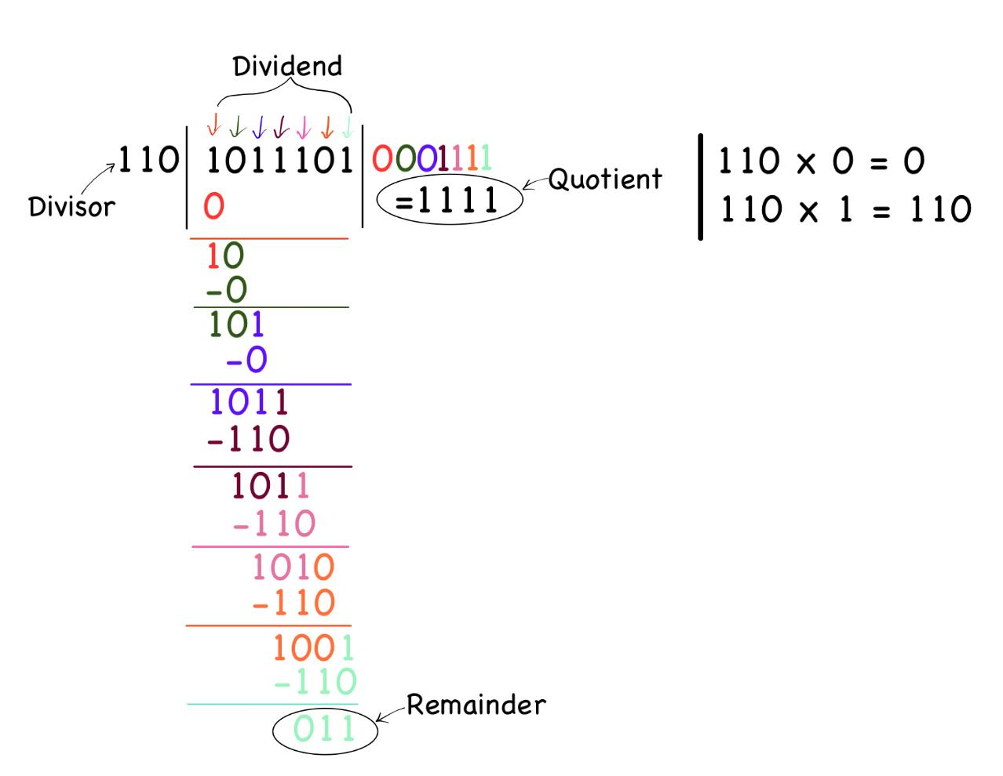
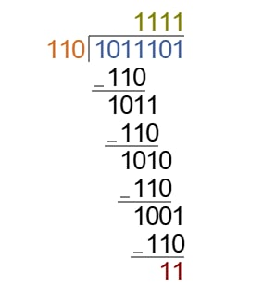
Exercise
(9) Perform
10111012 / 1102; Find the quotient and remainder
Solution
Alt. Solution
‹#›
Department of Computer Science and Engineering
CSE260 - Digital Logic Design

Slide 43
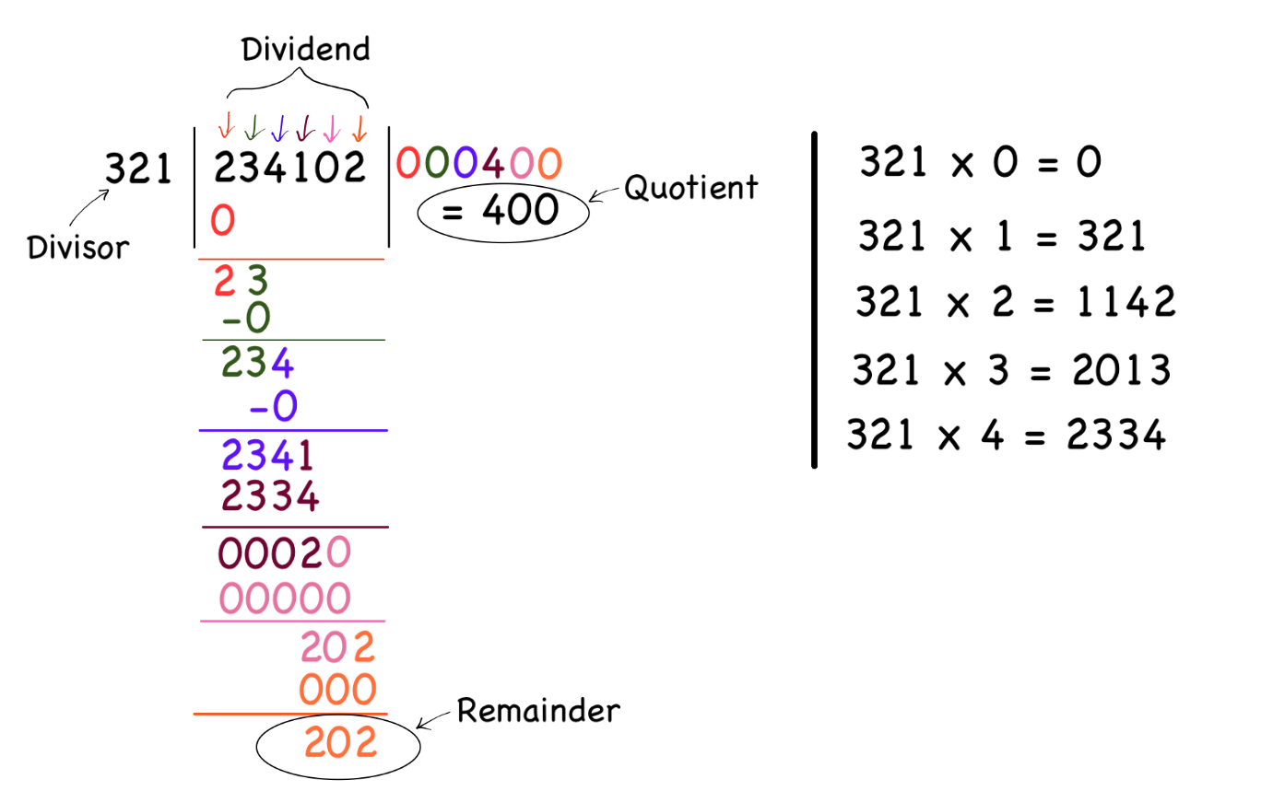
Exercise
(10) Perform 234102₅ / 321₅; Find the quotient and remainder.
Solution
‹#›
Department of Computer Science and Engineering
CSE260 - Digital Logic Design

Slide 44
Exercise
(11) (a) (71)₈/ (56)₈ (b) (21)₃/ (12)₃
Find the quotient and remainder.
Solution
Do it yourself & Compare the answer with your peers.
‹#›
Department of Computer Science and Engineering
CSE260 - Digital Logic Design

